Slide 1
Event Handling

Slide 2
Chapter Goals
To understand the Java event model
To install action and mouse event listeners
To accept input from buttons, text fields, and the mouse

Slide 3
Events, Event Sources, and Event Listeners
User interface events include key presses, mouse moves, button clicks, and so on
Most programs don't want to be flooded by boring events
A program can indicate that it only cares about certain specific events
Continued…

Slide 4
Events, Event Sources, and Event Listeners
Event listener:
  Notified when event happens
  Belongs to a class that is provided by the application programmer
  Its methods describe the actions to be taken when an event occurs
  A program indicates which events it needs to receive by installing event listener objects
Event source:
  Event sources report on events
  When an event occurs, the event source notifies all event listeners

Slide 5
Events, Event Sources, and Event Listeners
Example: Use JButton components for buttons; attach an ActionListener to each button
ActionListener interface:
Need to supply a class whose actionPerformed method contains instruc-tions to be executed when button is clicked
public interface ActionListener
{
void actionPerformed(ActionEvent event);
}

Slide 6
Events, Event Sources, and Event Listeners
event parameter contains details about the
event, such as the time at which it occurred
Construct an object of the listener and add it
to the button:
ActionListener listener = new ClickListener();
button.addActionListener(listener);

Slide 7
File ClickListener.java
01: import java.awt.event.ActionEvent;
02: import java.awt.event.ActionListener;
03:
04: /**
05: An action listener that prints a message.
06: */
07: public class ClickListener implements ActionListener
08: {
09: public void actionPerformed(ActionEvent event)
10: {
11: System.out.println("I was clicked.");
12: }
13: }

Slide 8
File ButtonTester.java
01: import java.awt.event.ActionListener;
02: import javax.swing.JButton;
03: import javax.swing.JFrame;
04:
05: /**
06: This program demonstrates how to install an action listener.
07: */
08: public class ButtonTester
09: {
10: public static void main(String[] args)
11: {
12: JFrame frame = new JFrame();
13: JButton button = new JButton("Click me!");
14: frame.add(button);
15:
Continued…

Slide 9
File ClickListener.java
16: ActionListener listener = new ClickListener();
17: button.addActionListener(listener);
18:
19: frame.setSize(FRAME_WIDTH, FRAME_HEIGHT);
20: frame.setDefaultCloseOperation(JFrame.EXIT_ON_CLOSE);
21: frame.setVisible(true);
22: }
23:
24: private static final int FRAME_WIDTH = 100;
25: private static final int FRAME_HEIGHT = 60;
26: }

Slide 10
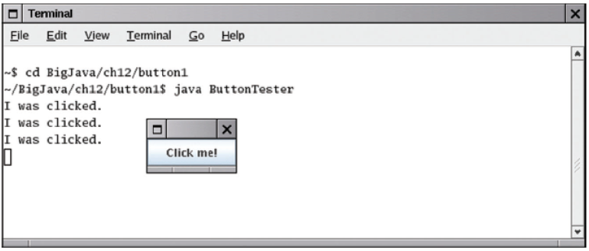
File ClickListener.java
Output:
Figure 1:
Implementing an Action Listener

Slide 11
Self Check
Which objects are the event source and the event listener in the ButtonTester program?
Why is it legal to assign a ClickListener object to a variable of type ActionListener?

Slide 12
Answers
The button object is the event source. The listener object is the event listener.
The ClickListener class implements the ActionListener interface.

Slide 13
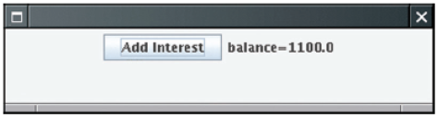
Building Applications With Buttons
Example: investment viewer program; whenever button is clicked, interest is added, and new balance is displayed
Table 2:
An Application With a Button
Continued…

Slide 14
Building Applications With Buttons
Construct an object of the JButton class:
We need a user interface component that displays a message:
JButton button = new JButton("Add Interest");
JLabel label = new JLabel("balance=" + account.getBalance());
Continued…

Slide 15
Building Applications With Buttons
Use a JPanel container to group multiple user interface components together:
JPanel panel = new JPanel();
panel.add(button);
panel.add(label);
frame.add(panel);

Slide 16
Building Applications With Buttons
Listener class adds interest and displays the new balance:
class AddInterestListener implements ActionListener
{
public void actionPerformed(ActionEvent event)
{
double interest = account.getBalance() * INTEREST_RATE / 100;
account.deposit(interest);
label.setText("balance=" + account.getBalance());
}
}
Continued…

Slide 17
Building Applications With Buttons
Add AddInterestListener as inner class so it can have access to surrounding final variables (account and label)

Slide 18
File InvestmentViewer1.java
01: import java.awt.event.ActionEvent;
02: import java.awt.event.ActionListener;
03: import javax.swing.JButton;
04: import javax.swing.JFrame;
05: import javax.swing.JLabel;
06: import javax.swing.JPanel;
07: import javax.swing.JTextField;
08:
09: /**
10: This program displays the growth of an investment.
11: */
12: public class InvestmentViewer1
13: {
14: public static void main(String[] args)
15: {
16: JFrame frame = new JFrame();
17:
Continued…

Slide 19
File InvestmentViewer1.java
18: // The button to trigger the calculation
19: JButton button = new JButton("Add Interest");
20:
21: // The application adds interest to this bank account
22: final BankAccount account
= new BankAccount(INITIAL_BALANCE);
23:
24: // The label for displaying the results
25: final JLabel label = new JLabel(
26: "balance=" + account.getBalance());
27:
28: // The panel that holds the user interface components
29: JPanel panel = new JPanel();
30: panel.add(button);
31: panel.add(label);
32: frame.add(panel);
33:
Continued…

Slide 20
File InvestmentViewer1.java
34: class AddInterestListener implements ActionListener
35: {
36: public void actionPerformed(ActionEvent event)
37: {
38: double interest = account.getBalance()
39: * INTEREST_RATE / 100;
40: account.deposit(interest);
41: label.setText(
42: "balance=" + account.getBalance());
43: }
44: }
45:
46: ActionListener listener = new AddInterestListener();
47: button.addActionListener(listener);
48:
49: frame.setSize(FRAME_WIDTH, FRAME_HEIGHT);
50: frame.setDefaultCloseOperation(JFrame.EXIT_ON_CLOSE);
51: frame.setVisible(true);
52: }
Continued…

Slide 21
File InvestmentViewer1.java
53:
54: private static final double INTEREST_RATE = 10;
55: private static final double INITIAL_BALANCE = 1000;
56:
57: private static final int FRAME_WIDTH = 400;
58: private static final int FRAME_HEIGHT = 100;
59: }

Slide 22
Self Check
How do you place the "balance = . . ." message to the left of the "Add Interest" button?
Why was it not necessary to declare the button variable as final?

Slide 23
Answers
First add label to the panel, then add button.
The actionPerformed method does not access that variable.

Slide 24
Processing Text Input
Use JTextField components to provide space for user input
Place a JLabel next to each text field
Supply a button that the user can press to indicate that the input is ready for processing
final int FIELD_WIDTH = 10; // In characters
final JTextField rateField = new JTextField(FIELD_WIDTH);
JLabel rateLabel = new JLabel("Interest Rate: ");
Continued…

Slide 25
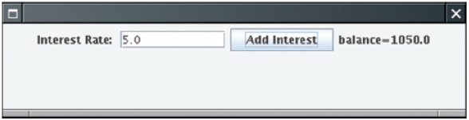
Processing Text Input
Figure 3:
An Application With a Text Field
Continued…

Slide 26
Processing Text Input
The button's actionPerformed method reads the user input from the text fields (use getText)
class AddInterestListener implements ActionListener
{
public void actionPerformed(ActionEvent event)
{
double rate = Double.parseDouble(rateField.getText());
. . .
}
}

Slide 27
File InvestmentViewer2.java
01: import java.awt.event.ActionEvent;
02: import java.awt.event.ActionListener;
03: import javax.swing.JButton;
04: import javax.swing.JFrame;
05: import javax.swing.JLabel;
06: import javax.swing.JPanel;
07: import javax.swing.JTextField;
08:
09: /**
10: This program displays the growth of an investment.
11: */
12: public class InvestmentViewer2
13: {
14: public static void main(String[] args)
15: {
16: JFrame frame = new JFrame();
17:
Continued…

Slide 28
File InvestmentViewer2.java
18: // The label and text field for entering the
//interest rate
19: JLabel rateLabel = new JLabel("Interest Rate: ");
20:
21: final int FIELD_WIDTH = 10;
22: final JTextField rateField
= new JTextField(FIELD_WIDTH);
23: rateField.setText("" + DEFAULT_RATE);
24:
25: // The button to trigger the calculation
26: JButton button = new JButton("Add Interest");
27:
28: // The application adds interest to this bank account
29: final BankAccount account
= new BankAccount(INITIAL_BALANCE);
30:
31: // The label for displaying the results
32: final JLabel resultLabel = new JLabel(
33: "balance=" + account.getBalance());
34:
Continued…

Slide 29
File InvestmentViewer2.java
35: // The panel that holds the user interface components
36: JPanel panel = new JPanel();
37: panel.add(rateLabel);
38: panel.add(rateField);
39: panel.add(button);
40: panel.add(resultLabel);
41: frame.add(panel);
42:
43: class AddInterestListener implements ActionListener
44: {
45: public void actionPerformed(ActionEvent event)
46: {
47: double rate = Double.parseDouble(
48: rateField.getText());
49: double interest = account.getBalance()
50: * rate / 100;
51: account.deposit(interest);
Continued…

Slide 30
File InvestmentViewer2.java
52: resultLabel.setText(
53: "balance=" + account.getBalance());
54: }
55: }
56:
57: ActionListener listener = new AddInterestListener();
58: button.addActionListener(listener);
59:
60: frame.setSize(FRAME_WIDTH, FRAME_HEIGHT);
61: frame.setDefaultCloseOperation(JFrame.EXIT_ON_CLOSE);
62: frame.setVisible(true);
63: }
64:
65: private static final double DEFAULT_RATE = 10;
66: private static final double INITIAL_BALANCE = 1000;
67:
68: private static final int FRAME_WIDTH = 500;
69: private static final int FRAME_HEIGHT = 200;
70: }

Slide 31
Self Check
What happens if you omit the first JLabel object?
If a text field holds an integer, what expression do you use to read its contents?

Slide 32
Answers
Then the text field is not labeled, and the user will not know its purpose.
Integer.parseInt(textField.getText())

Slide 33
Mouse Events
Use a mouse listener to capture mouse events
Implement the MouseListener interface:
public interface MouseListener
{
void mousePressed(MouseEvent event);
// Called when a mouse button has been pressed on a component
void mouseReleased(MouseEvent event);
// Called when a mouse button has been released on a component
void mouseClicked(MouseEvent event);
// Called when the mouse has been clicked on a component
void mouseEntered(MouseEvent event);
// Called when the mouse enters a component
void mouseExited(MouseEvent event);
// Called when the mouse exits a component
}
Continued…

Slide 34
Mouse Events
mousePressed, mouseReleased: called when a mouse button is pressed or released
mouseClicked: if button is pressed and released in quick succession, and mouse hasn't moved
mouseEntered, mouseExited: mouse has entered or exited the component's area

Slide 35
Mouse Events
Add a mouse listener to a component by calling the addMouseListener method:
public class MyMouseListener implements MouseListener
{
// Implements five methods
}
MouseListener listener = new MyMouseListener();
component.addMouseListener(listener);
Continued…

Slide 36
Mouse Events
Sample program: enhance RectangleComponentViewer program of Chapter 5; when user clicks on rectangle component, move the rectangle

Slide 37
File RectangleComponent.java
01: import java.awt.Graphics;
02: import java.awt.Graphics2D;
03: import java.awt.Rectangle;
04: import javax.swing.JComponent;
05:
06: /**
07: This component lets the user move a rectangle by
08: clicking the mouse.
09: */
10: public class RectangleComponent extends JComponent
11: {
12: public RectangleComponent()
13: {
14: // The rectangle that the paint method draws
15: box = new Rectangle(BOX_X, BOX_Y,
16: BOX_WIDTH, BOX_HEIGHT);
17: }
18:
Continued…

Slide 38
File RectangleComponent.java
19: public void paintComponent(Graphics g)
20: {
21: super.paintComponent(g);
22: Graphics2D g2 = (Graphics2D) g;
23:
24: g2.draw(box);
25: }
26:
27: /**
28: Moves the rectangle to the given location.
29: @param x the x-position of the new location
30: @param y the y-position of the new location
31: */
32: public void moveTo(int x, int y)
33: {
34: box.setLocation(x, y);
35: repaint();
36: }
Continued…

Slide 39
File RectangleComponent.java
37:
38: private Rectangle box;
39:
40: private static final int BOX_X = 100;
41: private static final int BOX_Y = 100;
42: private static final int BOX_WIDTH = 20;
43: private static final int BOX_HEIGHT = 30;
44: }

Slide 40
Mouse Events
Call repaint when you modify the shapes that paintComponent draws box.setLocation(x, y); repaint();
Mouse listener: if the mouse is pressed, listener moves the rectangle to the mouse location
Continued…

Slide 41
Mouse Events
class MousePressListener implements MouseListener
{
public void mousePressed(MouseEvent event)
{
int x = event.getX();
int y = event.getY();
component.moveTo(x, y);
}
// Do-nothing methods
public void mouseReleased(MouseEvent event) {}
public void mouseClicked(MouseEvent event) {}
public void mouseEntered(MouseEvent event) {}
public void mouseExited(MouseEvent event) {}
}
All five methods of the interface must be implemented; unused methods can be empty

Slide 42
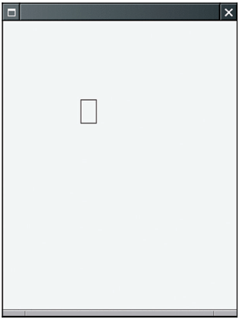
RectangleComponentViewer Program Output
Figure 4:
Clicking the Mouse Moves the Rectangle

Slide 43
File RectangleComponentViewer2.java
01: import java.awt.event.MouseListener;
02: import java.awt.event.MouseEvent;
03: import javax.swing.JFrame;
04:
05: /**
06: This program displays a RectangleComponent.
07: */
08: public class RectangleComponentViewer
09: {
10: public static void main(String[] args)
11: {
12: final RectangleComponent component
= new RectangleComponent();
13:
14: // Add mouse press listener
15:
16: class MousePressListener implements MouseListener
17: {
Continued…

Slide 44
File RectangleComponentViewer2.java
18: public void mousePressed(MouseEvent event)
19: {
20: int x = event.getX();
21: int y = event.getY();
22: component.moveTo(x, y);
23: }
24:
25: // Do-nothing methods
26: public void mouseReleased(MouseEvent event) {}
27: public void mouseClicked(MouseEvent event) {}
28: public void mouseEntered(MouseEvent event) {}
29: public void mouseExited(MouseEvent event) {}
30: }
31:
32: MouseListener listener = new MousePressListener();
33: component.addMouseListener(listener);
34:
Continued…

Slide 45
File RectangleComponentViewer2.java
35: JFrame frame = new JFrame();
36: frame.add(component);
37:
38: frame.setSize(FRAME_WIDTH, FRAME_HEIGHT);
39: frame.setDefaultCloseOperation(JFrame.EXIT_ON_CLOSE);
40: frame.setVisible(true);
41: }
42:
43: private static final int FRAME_WIDTH = 300;
44: private static final int FRAME_HEIGHT = 400;
45: }

Slide 46
Self Check
What would happen if you omitted the call to repaint in the moveTo method?
Why must the MousePressListener class supply five methods?

Slide 47
Answers
The rectangle would only be painted at the new location when the component is repainted for some other reason, for example, when the frame is resized.
It implements the MouseListener interface, which has five methods.

